Slide 1

Need for speed 8
Time to get your web
performance sorted

Slide 2
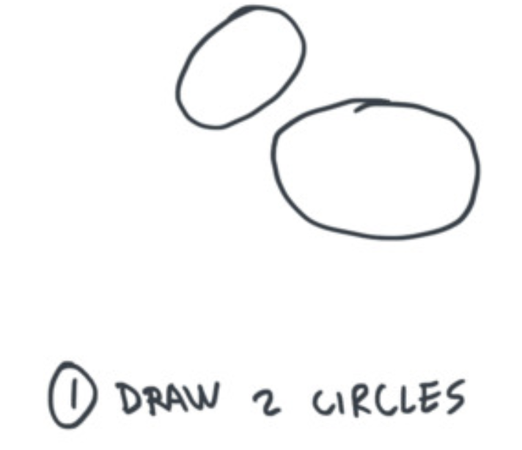

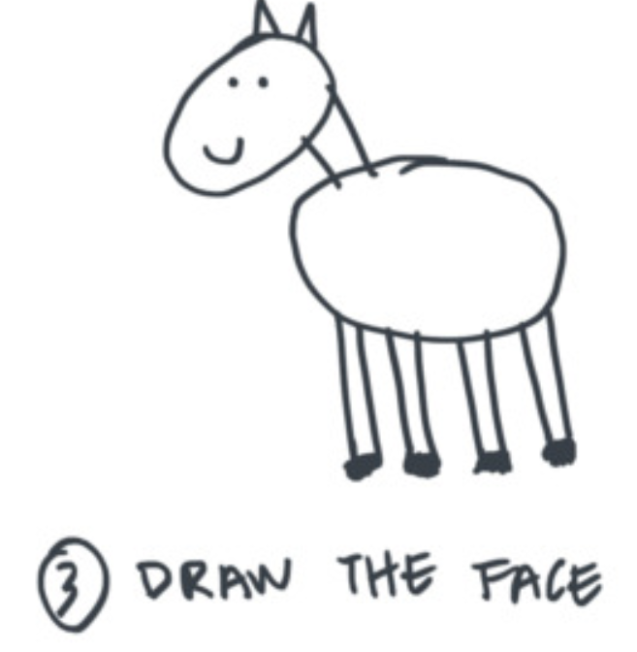



Slide 3


Slide 4




Olá!
Yaser Adel Mehraban
Lead front end engineer @Readify
@yashints

Slide 5
1
Why should we care?
@yashints

Slide 6
65.11%
5,200,000,000
76%

Slide 7

57%
Lower bounce rate for mobile
site visits that load < 5s
Source: DoubleClick
bit.ly/2c0Dfcv

Slide 8
79%
Shoppers who have trouble with site
performance won’t return
Source: Kissmetrics
bit.ly/1Bt0Ojx

Slide 9
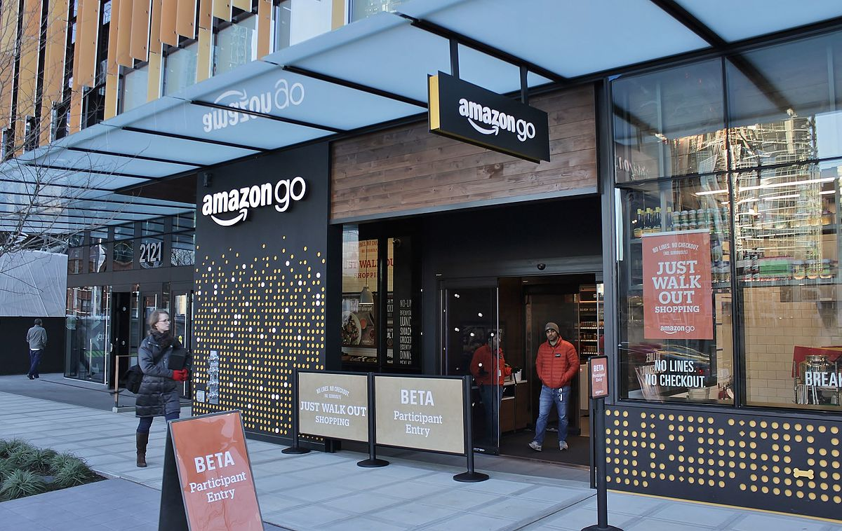
1 second delay = 7% reduction in conversions
$3,440,547
Source: Kissmetrics
bit.ly/1Dj8Koy

Slide 10
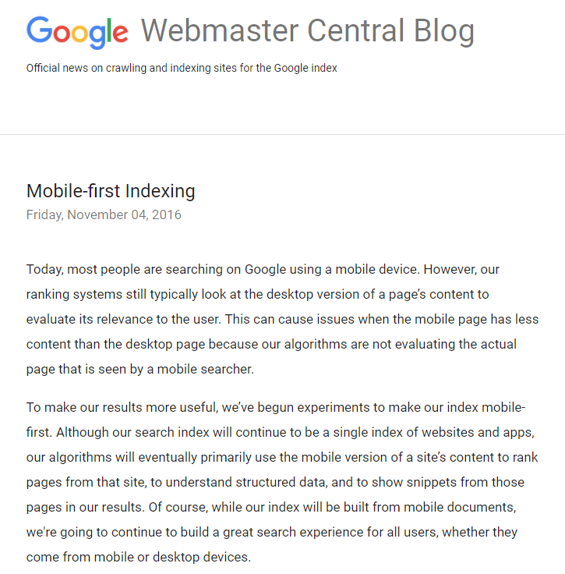
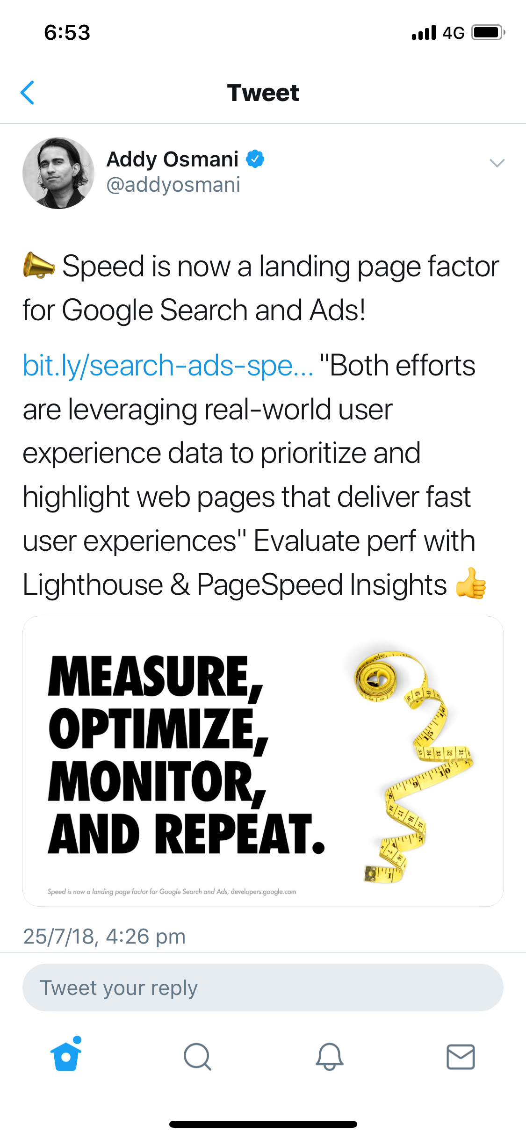
Watch out

Slide 11
OK we get it,
where to begin?
2
@yashints

Slide 12





Choose your metrics
First meaningful paint
Hero rendering time
Time to interactive
FPM, when primary content appears on the page
When the page's important content has finished rendering.
When a user can tap on UI and interact with it.
Input Responsiveness
Perceptual speed index
How much time it takes for an interface to respond to user's action.
Measures how quickly the page contents are visually populated; the lower the score, the better.

Slide 13
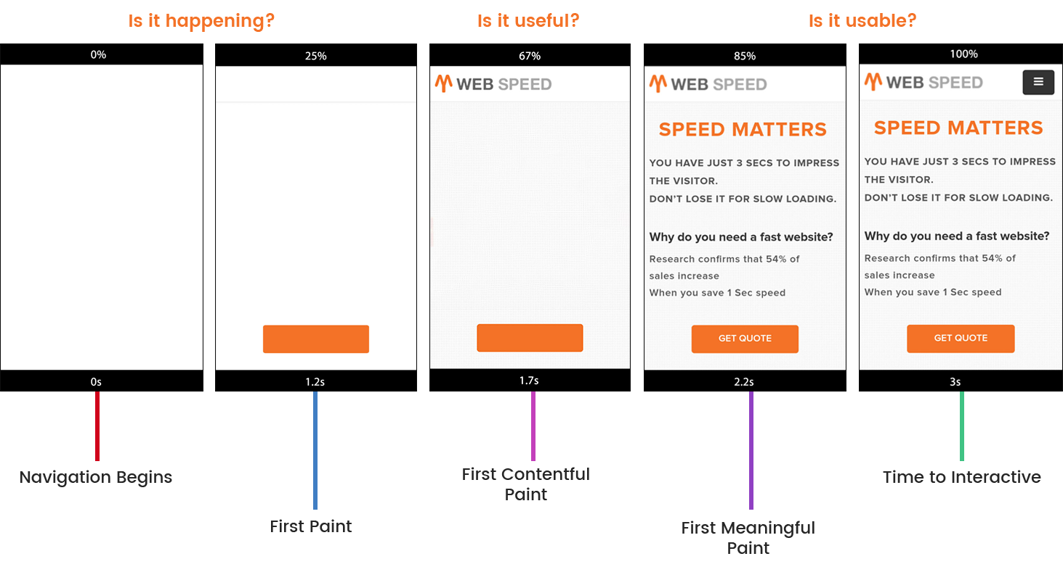
Speed Index

Slide 14

Start
with
data

Slide 15



Data sources
Field data
Lab data

Slide 16

Process
Field data
Field data
Lab data

Slide 17

Know your tools
Passive monitoring tools
Lighthouse
WebPageTest
Web.dev
Active monitoring tools
SpeedCurve
NewRelic

Slide 18
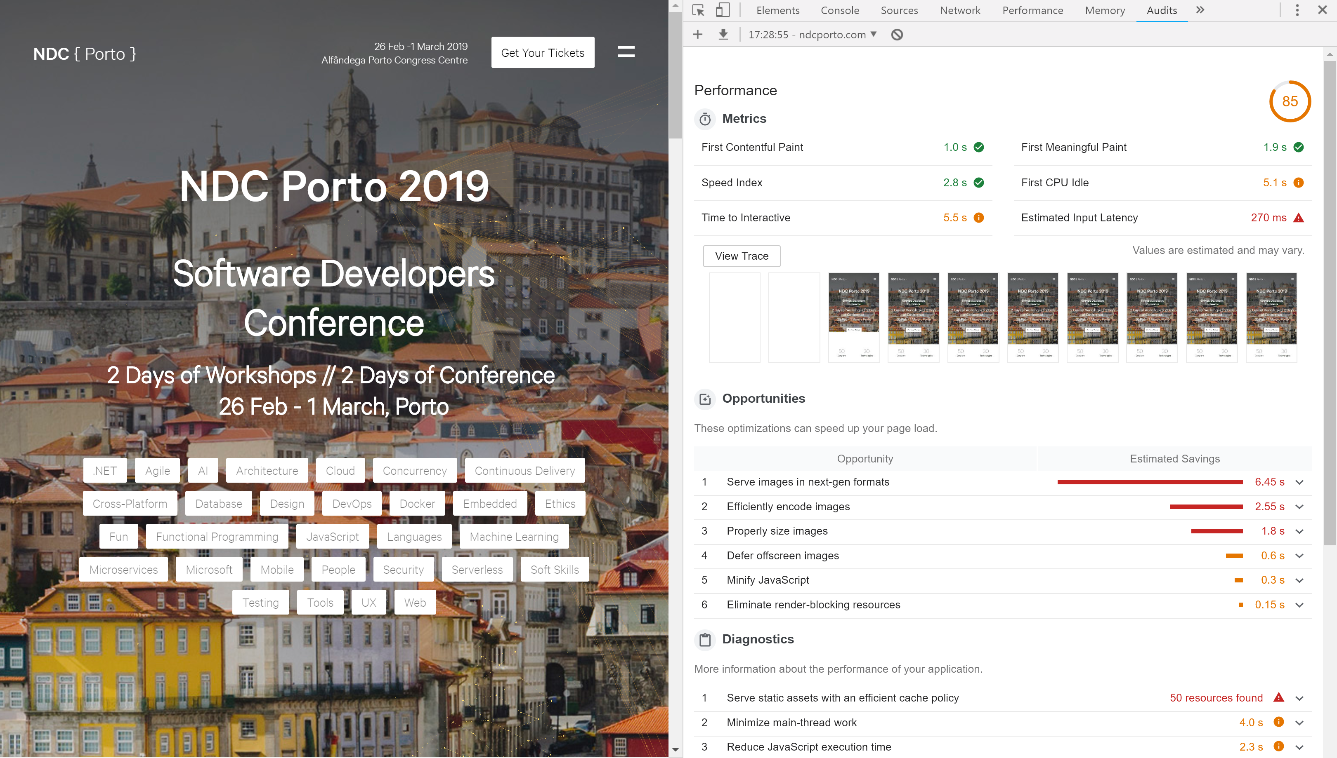
Lighthouse
Notes:
Audit
Performance
PWA
Accessibility
Best practices
SEO
Shows you areas that need improvement and how to fix them
Gives you hints on best practices which you can apply
So on

Slide 19
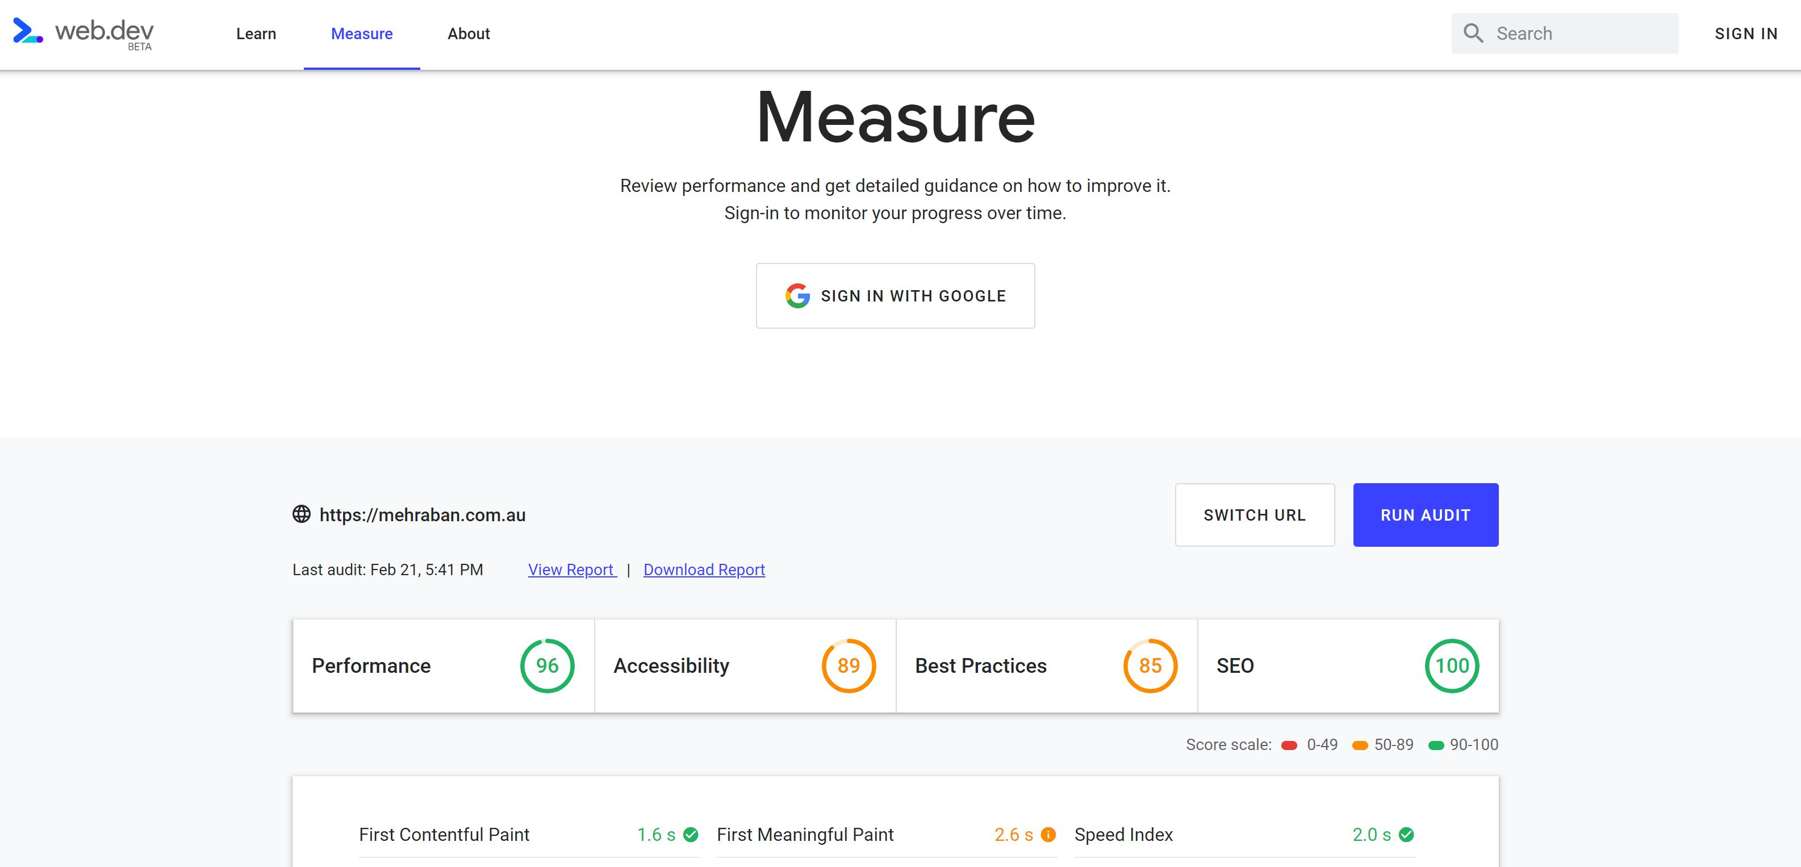

Slide 20


Goals

Slide 21

Goals
100 ms response
60 fps for animations
Only 16.6 ms for your code
SpeedIndex < 1250
TTI < 5s on 3G

Slide 22

Size
Max 170Kb gzipped
0.8-1MB decompressed

Slide 23


Slide 24

Average page size is 3Mb in 2018
Source: SpeedCurve yas.fyi/2MnCdXm

Slide 25


Slide 26



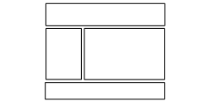




How browsers build the DOM
DOM
Run Selectors
Scripts
Layout
Paint
Load & Parse
Render Tree
Box Tree
CSSDOM

Slide 27
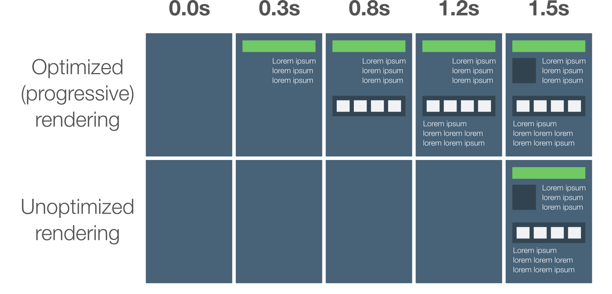
Source: google developers
yas.fyi/2zhGH0d
Notes:
Minimise the number of critical resources
Minimise the number of critical bytes
Minimise the critical path length

Slide 28
Stream HTML to the client
Get your CSS down fast

Slide 29




Have we missed anything?

Slide 30
JavaScript
External
Internal
Inline
Network request
Too much affects load time
Don’t even!

Slide 31

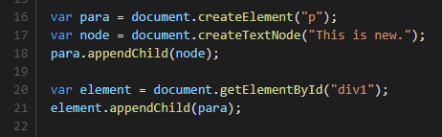
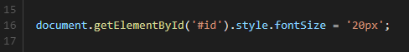
DOM
CSSDOM

Slide 32
Let’s get optimizing!
3
@yashints

Slide 33


PRPL
Push
Render
Pre-cache
Lazy load
https://developers.google.com/web/fundamentals/performance/prpl-pattern/

Slide 34
Styles
<link rel="preload">
Inline the critical CSS
Example
Use noscript

Slide 35
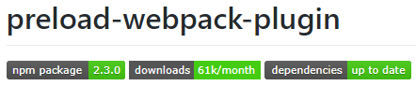

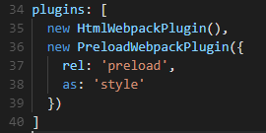

Slide 36
JavaScript
<script defer src=…
<script async src=…
Right before </body>
Code splitting
CommonChunkPlugin
Dynamic import/require
Analyse your bundle
(unused code/tree shaking)
webpack-bundle-analyzer

Slide 37
Web Fonts
A
Can be cached
Prefetch/Preload
Do you even need it?
eBay’s font loading strategy

Slide 38
Images
> 50% of page weight
Right dimensions
Next-gen formats
Compression => into build process
Lazy load’em (Intersection API)
Less of em

Slide 39
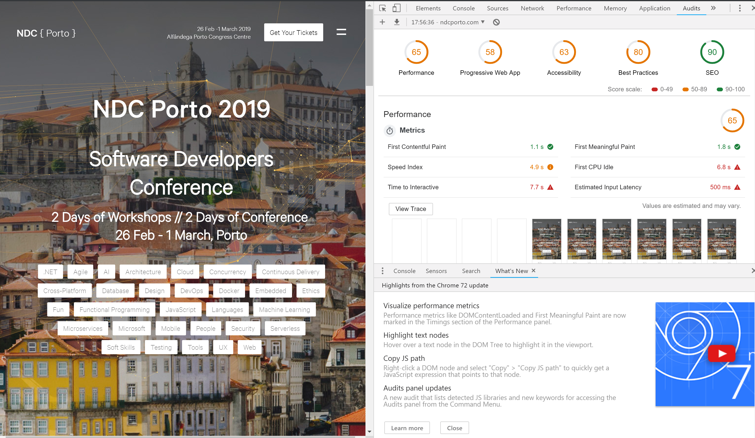

Slide 40

Progressive images

Slide 41
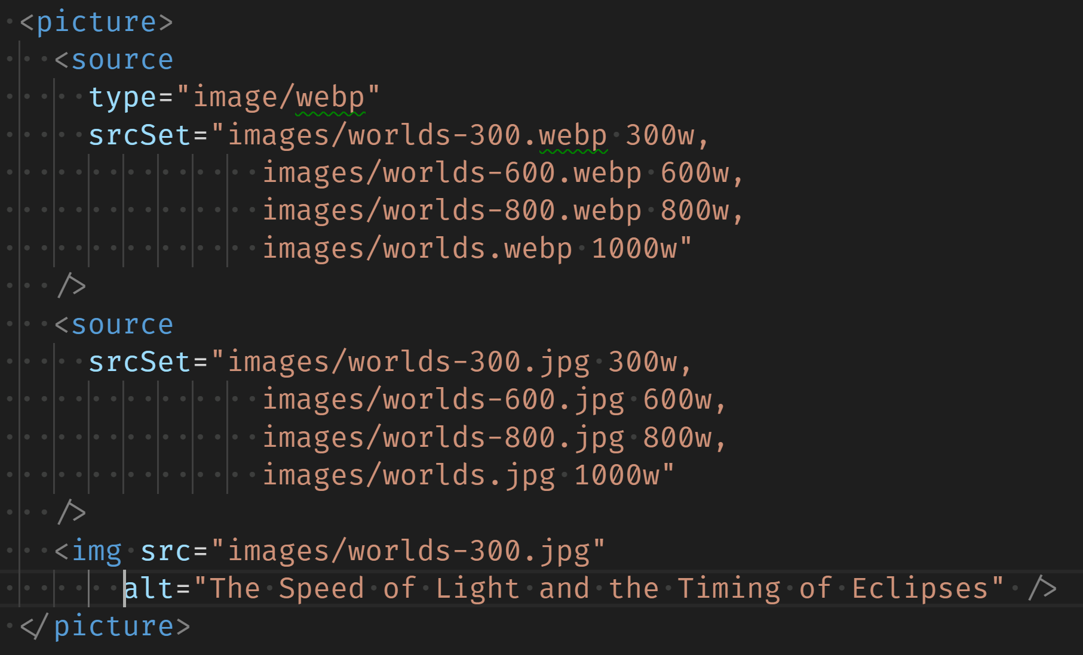
srcset

Slide 42
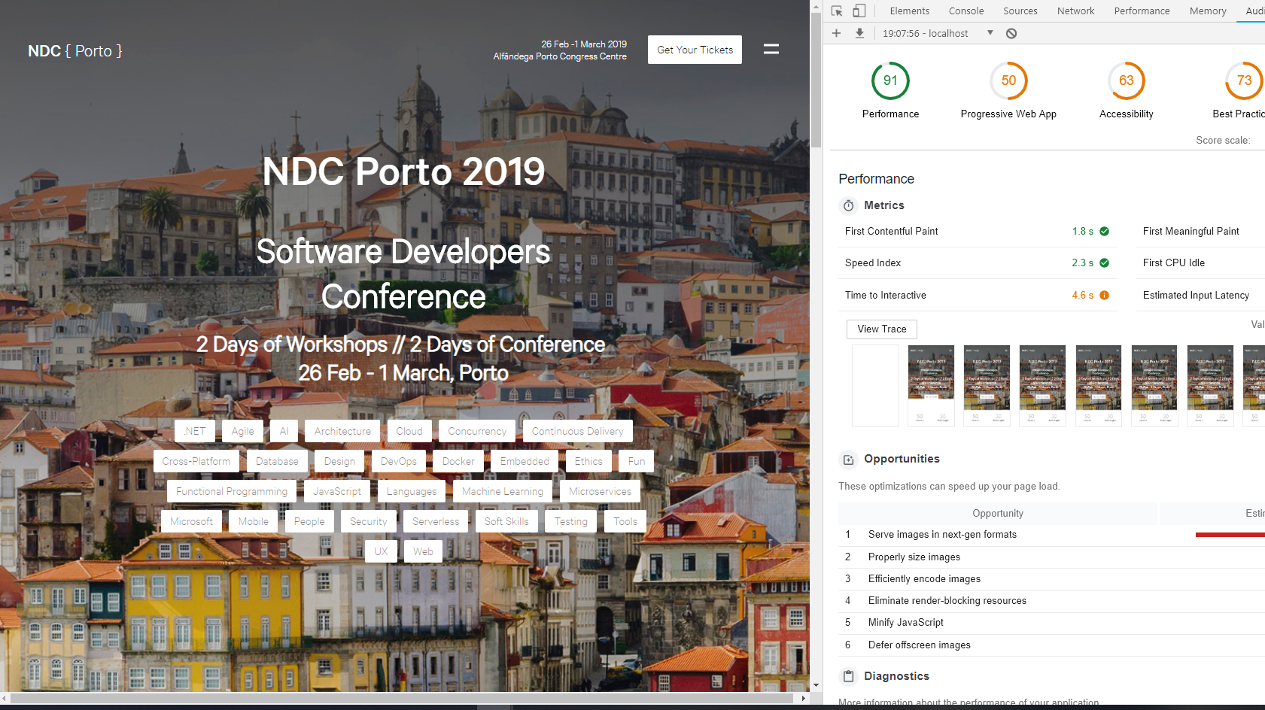

Slide 43
@yashints
Deploy – Field Data
03
Field Data
01
02
Improve – Lab Data

Slide 44



Demo

Slide 45
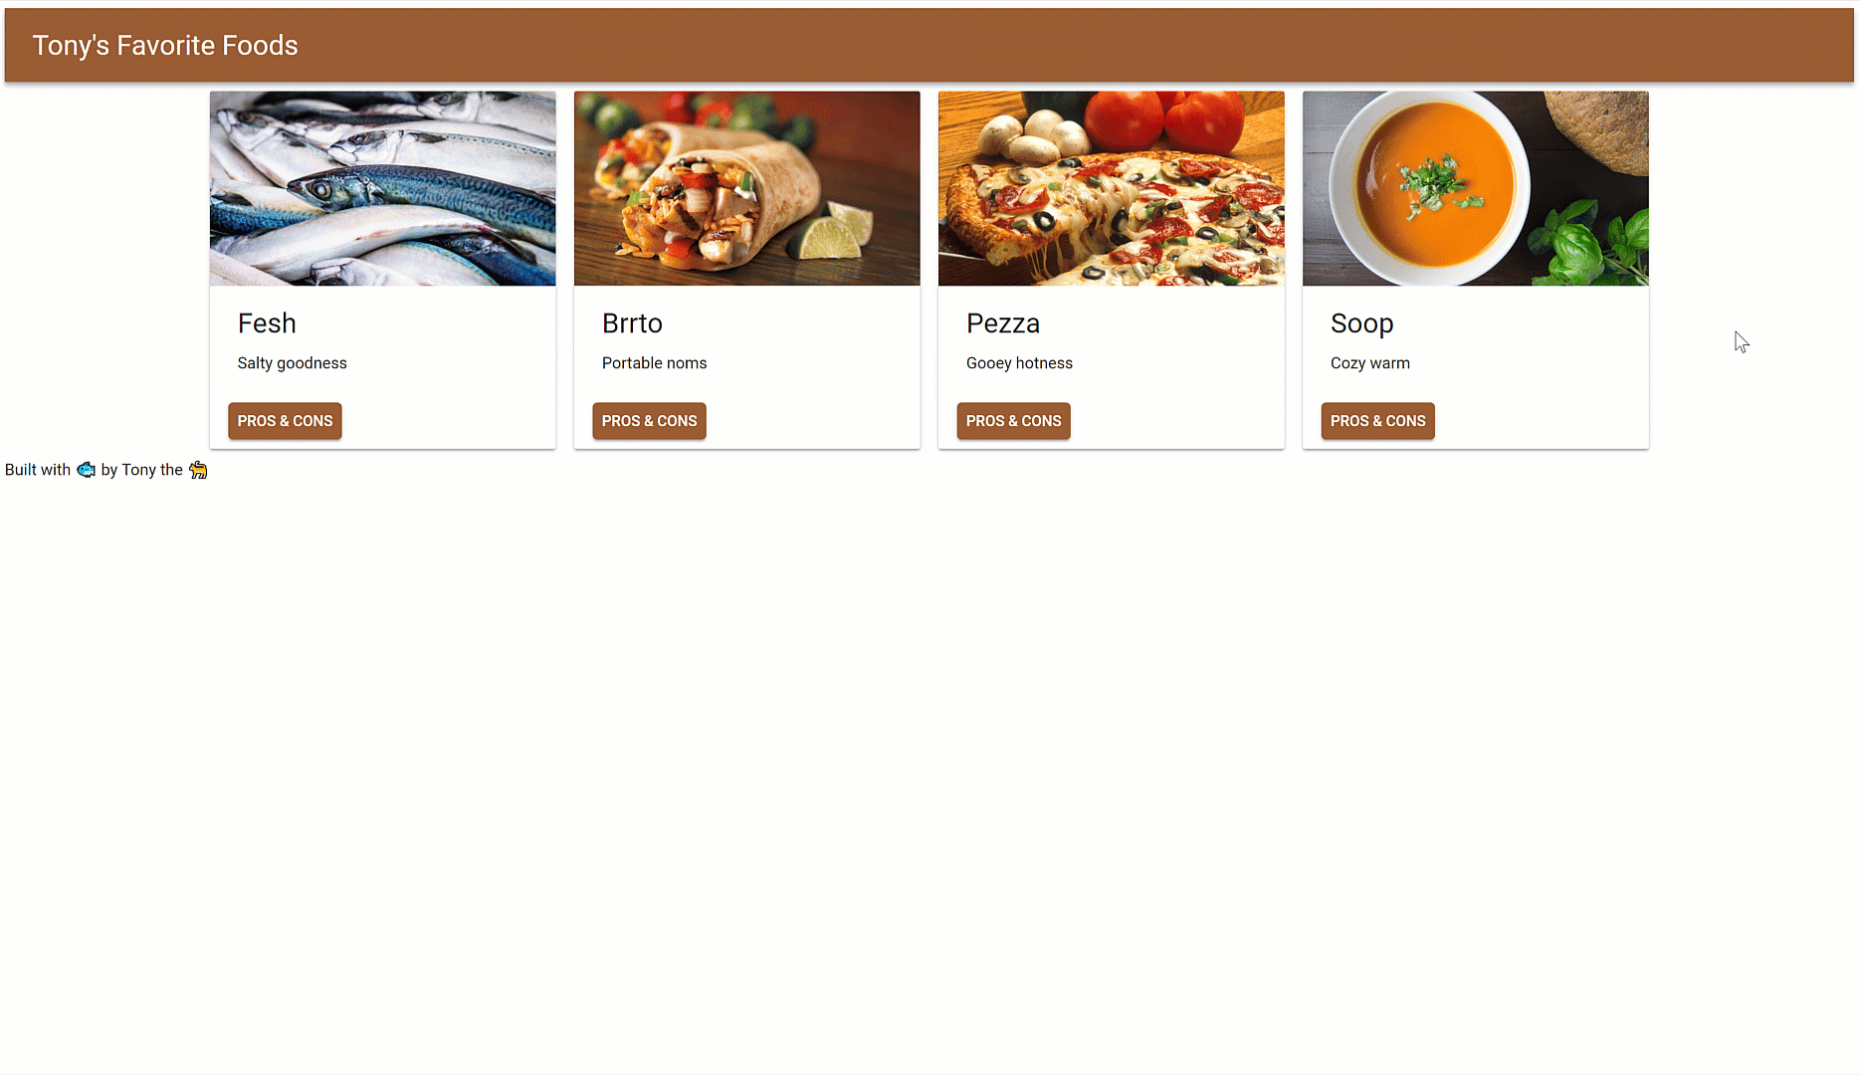

Slide 51
References
Front-end performance checklist
Google developers – Perf Matters
High Performance Web Fonts
Google developers – Image Optimisation
Slides
yas.fyi/2uOOAoh
yas.fyi/2JGQfS1
yas.fyi/2LBWnNl
yas.fyi/2LCyipJ
yas.fyi/2PRNuSy

Slide 52
Thanks!
Questions?
find me at:
@yashints
yaser@mehraban.com.au

